Slide 1
Node js REPL
Anju Munoth

Slide 2
Node.js REPL
Read Eval Print and Loop.
Specifies a computer environment like a window console or a Unix/Linux shell to enter the commands and the system responds with an output in an interactive mode.
Node.js or node comes bundled with REPL environment.
Each part of the REPL environment has a specific work.
Read: Reads user's input; parse the input into JavaScript data-structure and stores in memory.
Eval: Takes and evaluates the data structure.
Print: Prints the result.
Loop: Loops the above command until user press ctrl-c twice.

Slide 3
Start REPL
start REPL -Running "node" on the command prompt
Can write any mathematical expression
Variables are used to store values and print later.
If var keyword is not used to declare the variable ,then value is stored in the variable and printed whereas if var keyword is used then value is stored but not printed.
Can print variables using console.log().
supports multiline expressions like JavaScript
Can also use underscore _ to get the last result

Slide 4
REPL
Read-Eval-Print Loop is a simple, interactive computer programming environment.
Refer to a interactive environment but can be applied to command line shells and similar environments for programming languages like Python, Ruby etc.
In a REPL environment, user can enter one and more expressions, which are then evaluated (bypassing the compile stage), and the result displayed

Slide 5
Components of REPL
4 components to a REPL (comes from the names of the Lisp primitive functions ) :
A read function, which accepts an expression from the user and parses it into a data structure in memory .
An eval function, which takes the data structure and evaluates.
A print function, which prints the result.
A loop function, which runs the above three commands until termination

Slide 6
REPL in Node
Node.js ships with a REPL.
If you start the Node.js binary without any arguments, will see the REPL command prompt, the > character.
Works exactly the same as Chrome’s REPL, so from this prompt, can type any Javascript command you wish.
Extremely useful for experimenting with node.js and debugging JavaScript code.
Node comes with the REPL environment when it is installed. System interacts with the user through outputs of commands/expressions used.

Slide 7
REPL Features
Press Ctrl+C to terminate the current command.
Pressing Ctrl + C twice causes the REPL to quit.
Press Ctrl+D to exit the REPL.
Pressing up and down arrow keys can see command history and modify previous commands.
Press tab key to see the list of current commands. If you type a single character followed by tab it will show the list of keywords, functions, and variables starting with that particular character.
Can handle multiline expression.
Provides a special variable _ (underscore) which is used to pull the result of the last expression.

Slide 8
REPL Commands
Commands | Description
ctrl + c | is used to terminate the current command.
ctrl + c twice | terminates the node repl.
ctrl + d | terminates the node repl.
up/down keys | is used to see command history and modify previous commands.
tab keys | specifies the list of current command.
.help | specifies the list of all commands.
.break | is used to exit from multi-line expressions.
.clear | is used to exit from multi-line expressions.
.save filename | saves current node repl session to a file.
.load filename | is used to load file content in current node repl session.

Slide 9
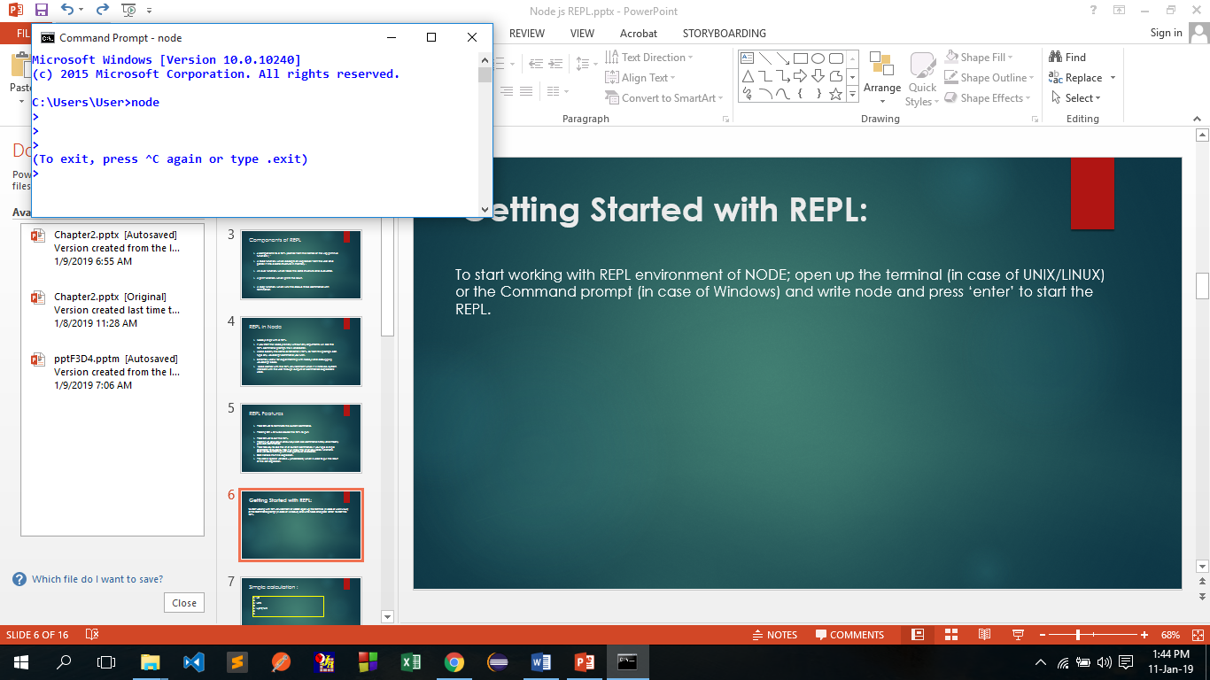
Getting Started with REPL:
To start working with REPL environment of NODE; open up the terminal (in case of UNIX/LINUX) or the Command prompt (in case of Windows) and write node and press ‘enter’ to start the REPL.
REPL has started and is demarcated by the ‘>’ symbol. Various operations can be performed on the REPL

Slide 10
Simple calculation :
> 1+2
3
> 1+2-3
0
> 1+(3-2)*4/2
3
>

Slide 11
Expressions in REPL
> var x = 10;
undefined
> var y = 20;
undefined
> x+y
30
>console.log(x+y);
30
undefined
>
Two variables x and y have declared with initial values 10 and 20. In both cases, REPL prints "undefined" because the variable declaration statements do not return any value.
The next statement x+y returns the value 30.
After execution of console.log(x+y) function, REPL prints the value of x+y and displays "undefined" again because console.log() function returns no value.

Slide 12
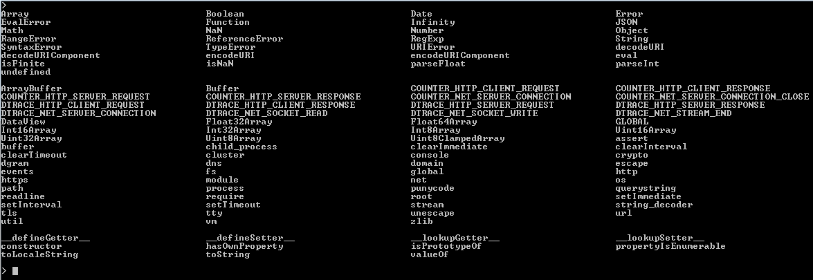
Example: List of current commands: Press tab key to see the list of current commands.

Slide 13
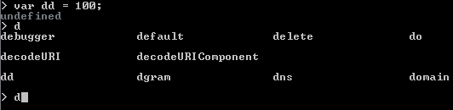
In the following list character d is pressed followed by the tab and the REPL displays the list of keywords, functions, and variables starting with that particular character.

Slide 14
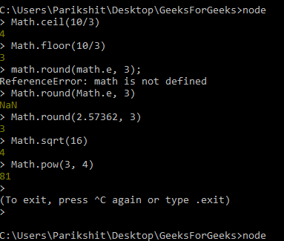
Example: Performing operations using libraries of NODE. MATH library is being used in below example.

Slide 15
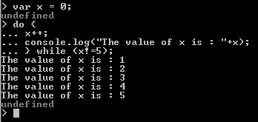
Example: Multiline expression
REPL can handle multiline expression smoothly. Start to enter a command, function or another unclosed tag into the REPL, and the REPL automatically extends to multiple lines. See the following example :
Note : The ... is used by the REPL to indicate a multiline expression.

Slide 16
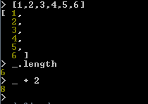
Example: special variable _ (underscore)
special variable _ (underscore) contains the result of the last expression. In the following example, _ variable first display the length of the declared array i.e. 6 and again display 8 after adding 2 to it.

Slide 17
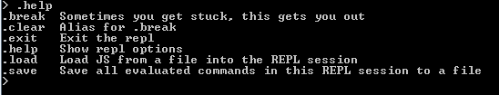
.help:
.help command is used to display all the available REPL commands.

Slide 18

.break:
.break command is used to exit from a multi-line expression, the command is useful if you make something wrong or do not want to complete or want to start over again. In the following example, a .break command is used to terminate a do..while loop before completing.

Slide 19
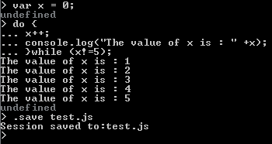
.save:
.save command is used to save the current REPL session to a file. In the following example, the current session is saved to the file test.js.

Slide 20
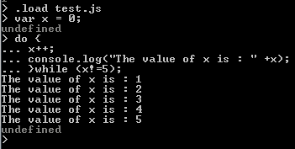
.load:
The .load command is used to load the contents of a file into the current REPL session. In the following example .load command loads previously saved file test.js.

Slide 21
Eval Option
If all we need is a quick set of statements, there’s a eval -e option that allows us to run inline JavaScript/Node.js.
For example, to print the current date, run this in your Terminal / Command Prompt:
node -e "console.log(new Date())"
Another example prints Node version:
node -e "console.log(process.versions.node)"
Node eval (-e flag) is useful in npm and bash scripts because it allows you to execute Node in a very compact manner in the bash, zsh or any other shell environment without having to have a Node file.
Can get versions, OS information or run any Node code such as working with a file system, database or HTTP.

Slide 22
Launching Node Code from a File
To run a Node.js script from a file, simply type
node filename.
For example, to launch code from a program.js file which is located in a current folder, simply execute
node program.js
The file must be in the same folder.
If you need to execute code from a file which is in a different folder, just provide the relative or absolute path:
node ./app/server.js
node /var/www/app/server.js

Slide 23
Launching Node Code from a File
The .js is optional as long as you have a file with such extension.
node server
If you have index.js in a folder, you can simply execute with a dot/period/full stop which in POSIX means the current folder or with a path to that folder.
node .
node /var/www/app
Are equivalent to
node index.js
node index
and
node /var/www/app/index.js
node /var/www/app/index

